Slide 1
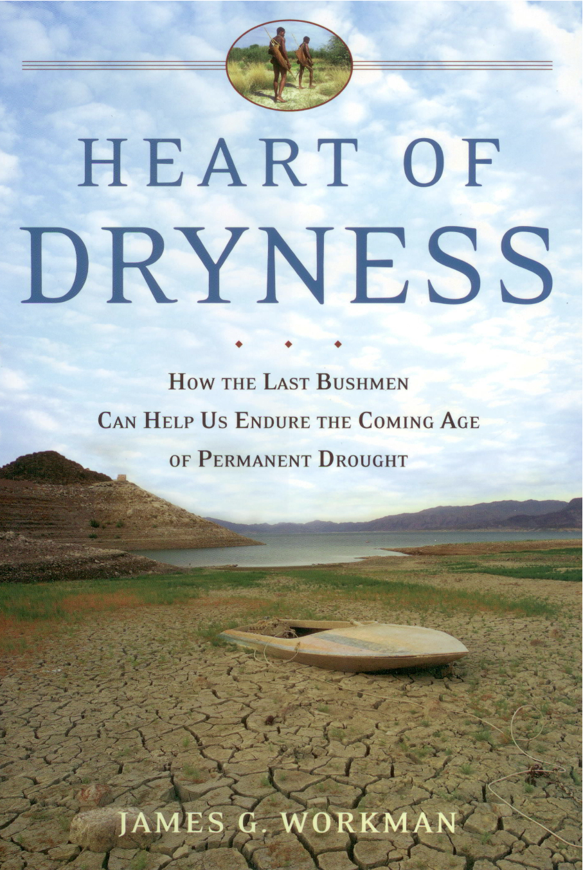

Slide 2
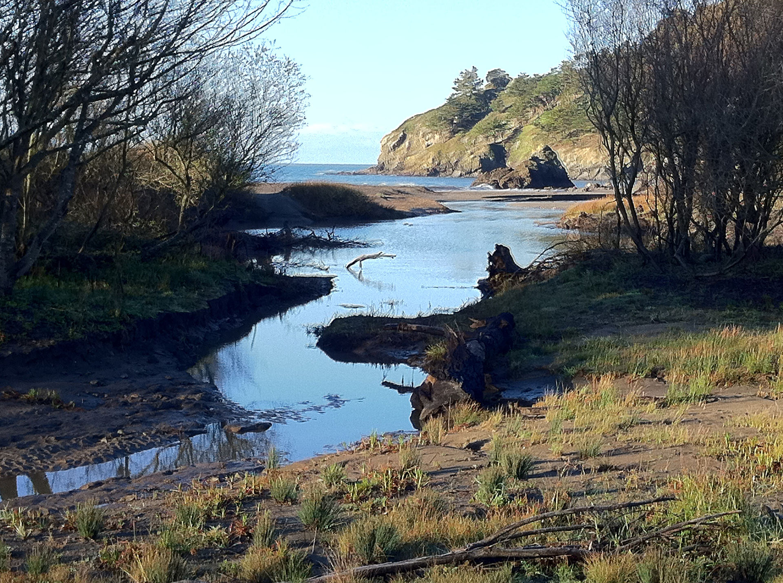

Slide 3
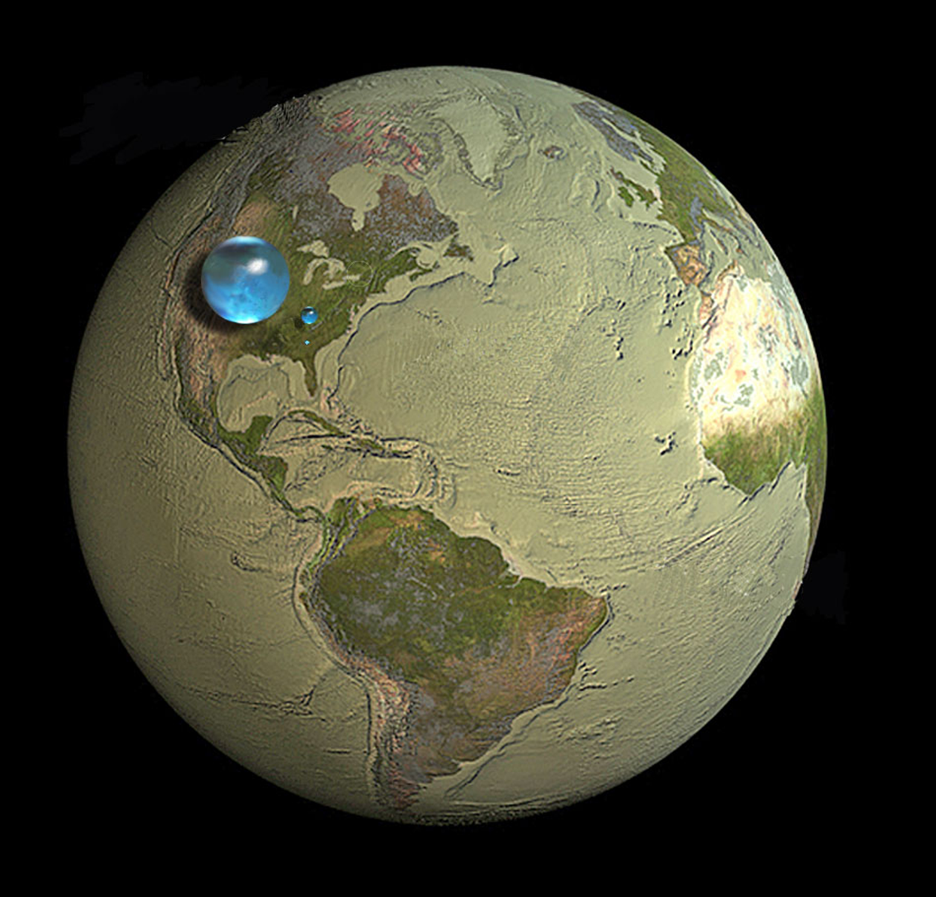

Slide 4
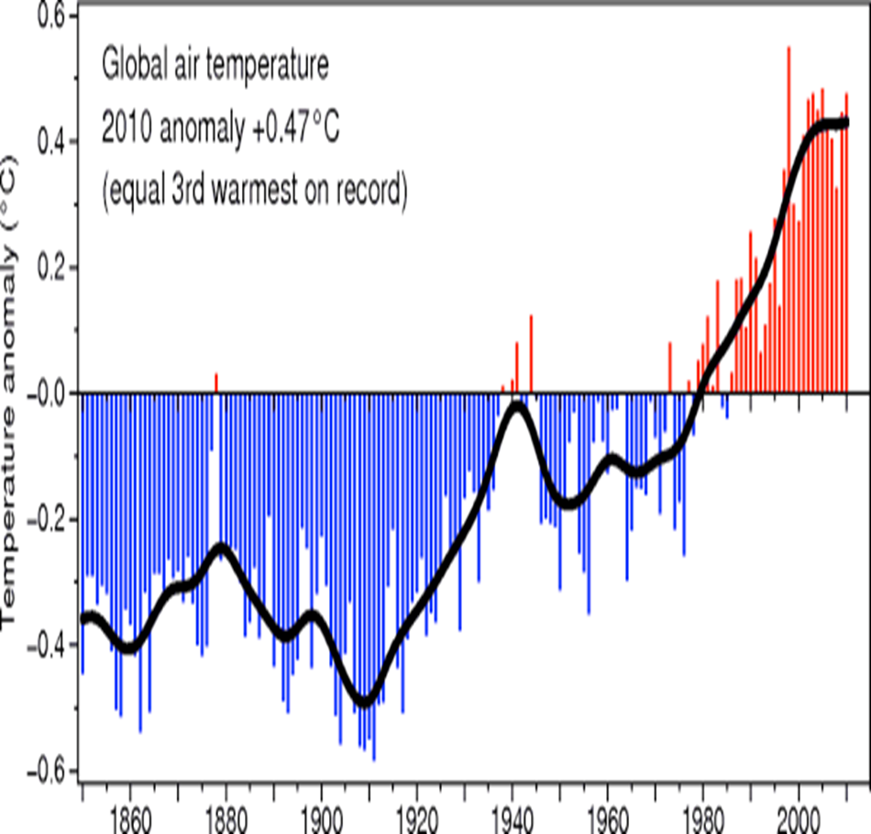

Slide 5
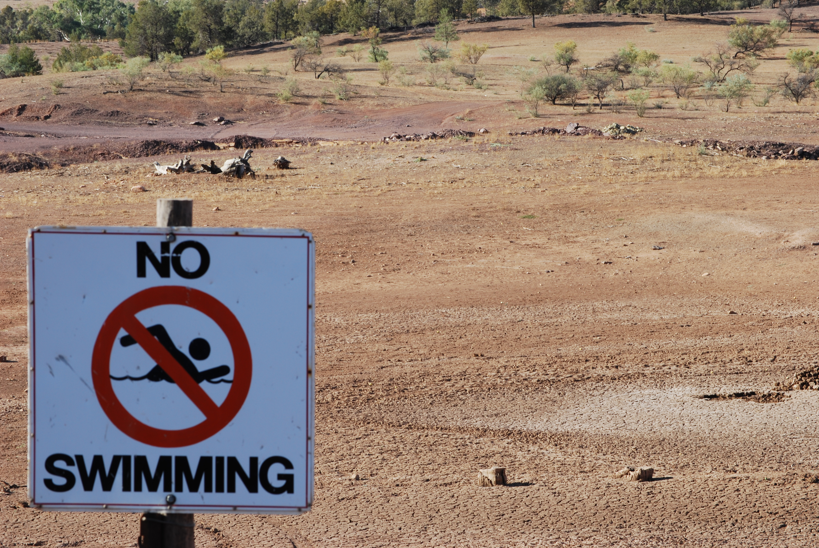

Slide 6
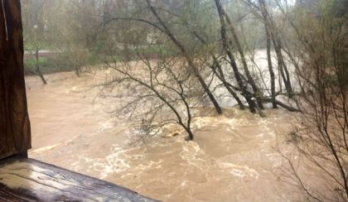
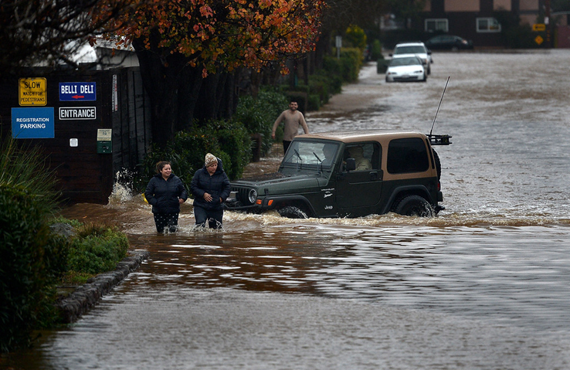

Slide 7
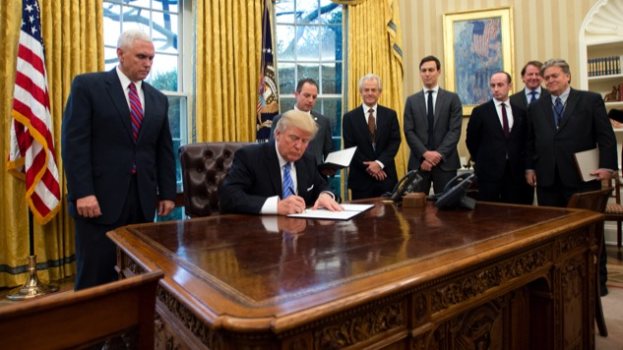

Slide 8
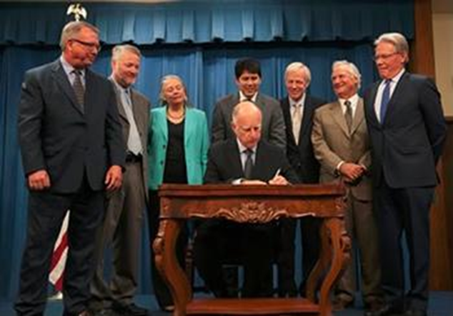

Slide 9
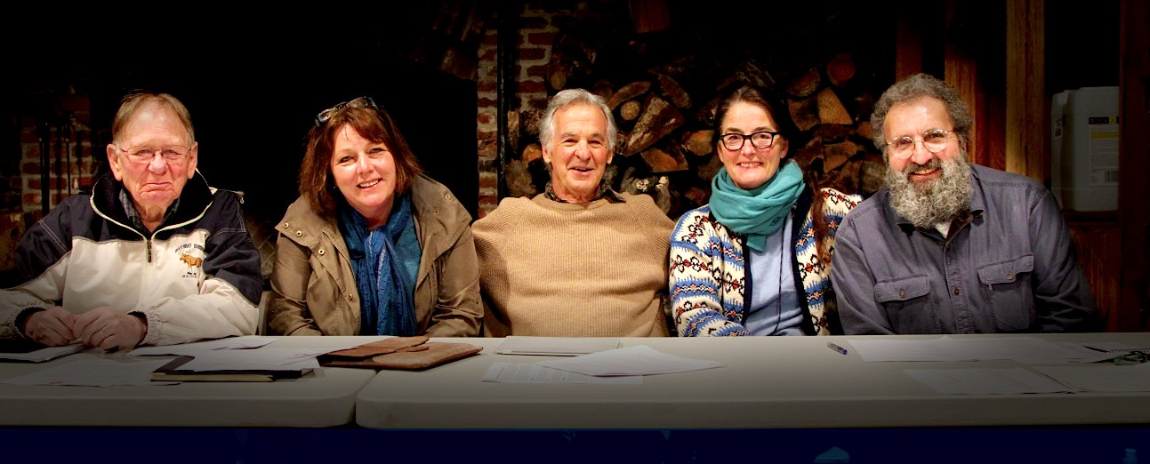

Slide 10
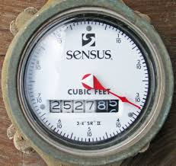
Rations!
Rations?

Slide 11
Muir Beach Ten Commandments
Restrictions?
Thou shalt not hose down thy driveway.
Thou shalt sprinkle thy lawn Monday and Thursday only.
Thou shalt not serve water unto thirsty diners until asked.
Thou shalt hold back drips in thy leaky pipes.
Thou shalt run thy dishwashers only whence full.
Thou shalt not water thy garden after the sun ariseth.
Thou shalt wash thy car only with a shut-off staff.
Thou shalt not use thy toilet as a garbage can.
Thou shalt prevent runoff unto thine gutters.
Thou shalt shorten thy nice long hot shower.

Slide 13
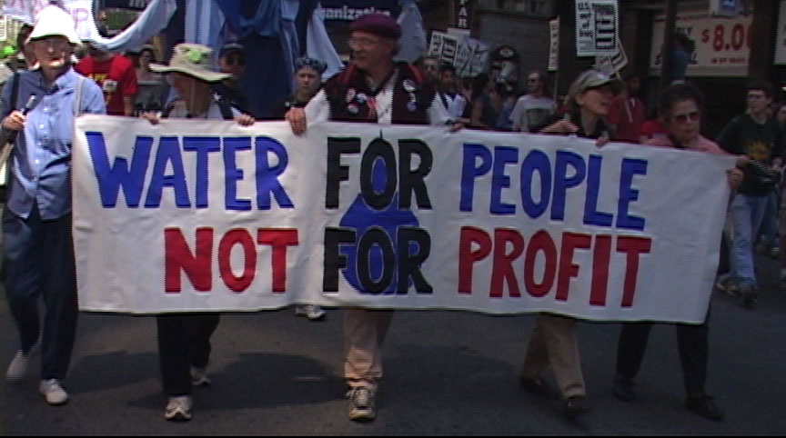
Reactions!

Slide 14
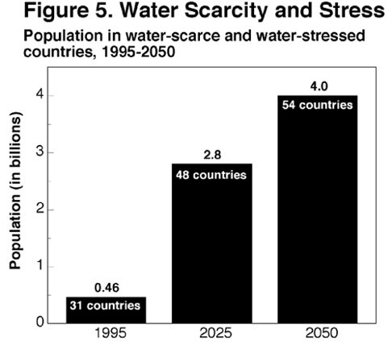
Tragic commons
“No owner/value in exchange”
Waste
Conflict
Extinction
Water Scarcity

Slide 15
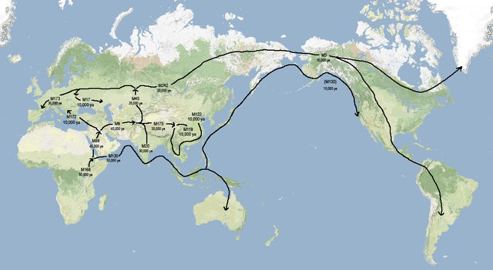

Slide 16
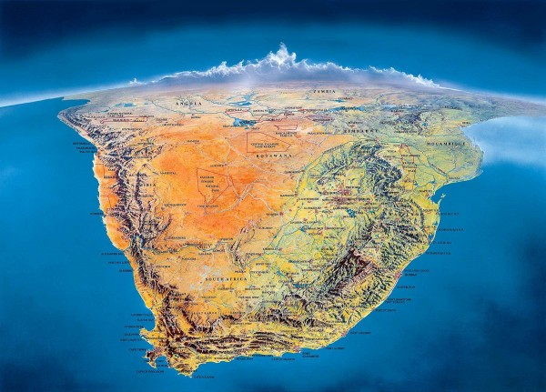
Oldest civilization

Slide 17
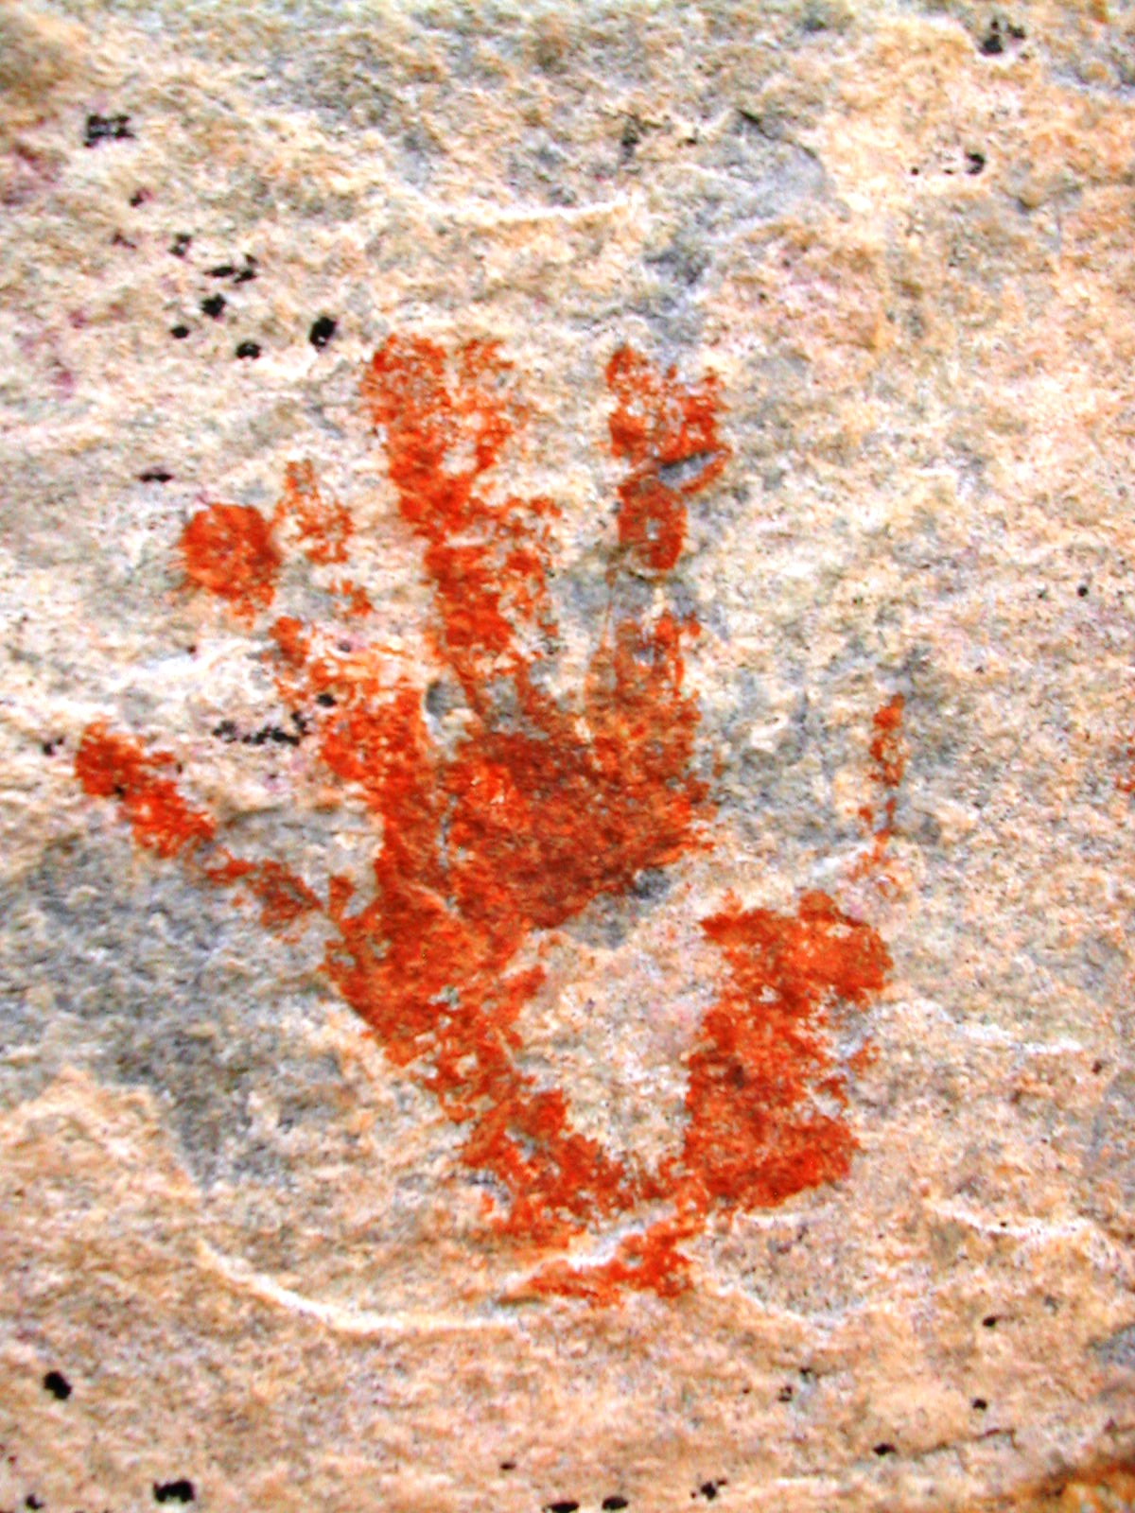
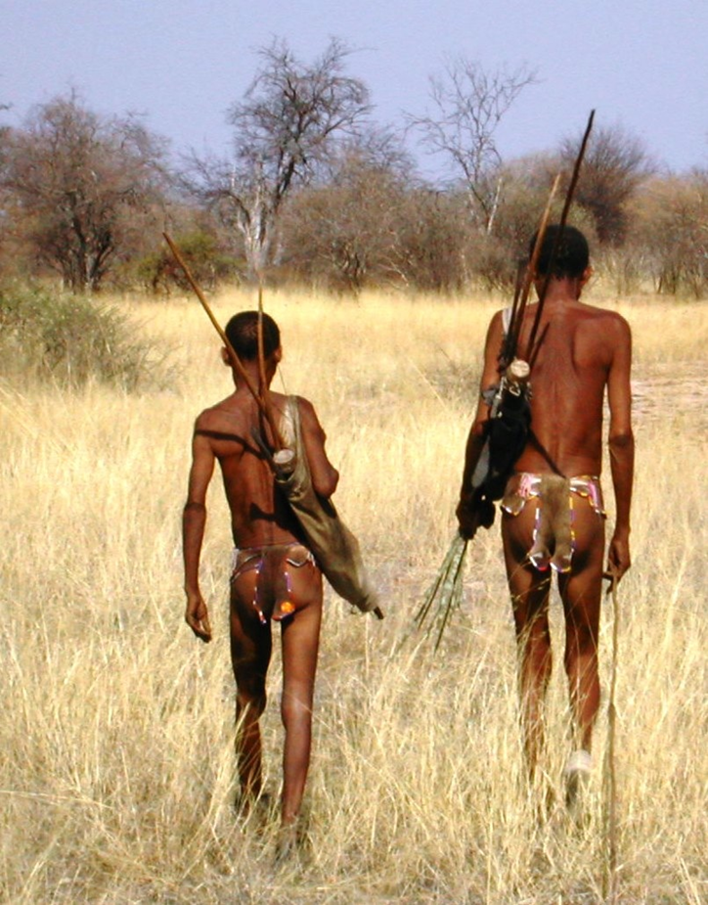

Slide 18
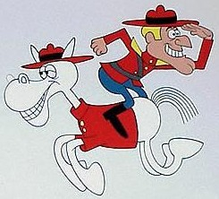

Slide 19
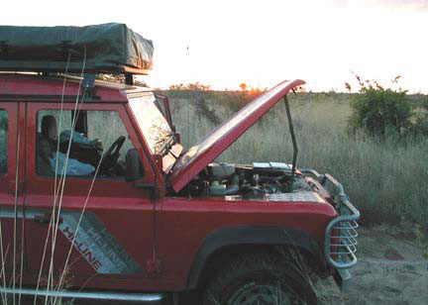

Slide 20
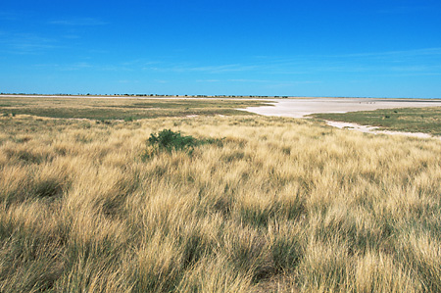

Slide 21
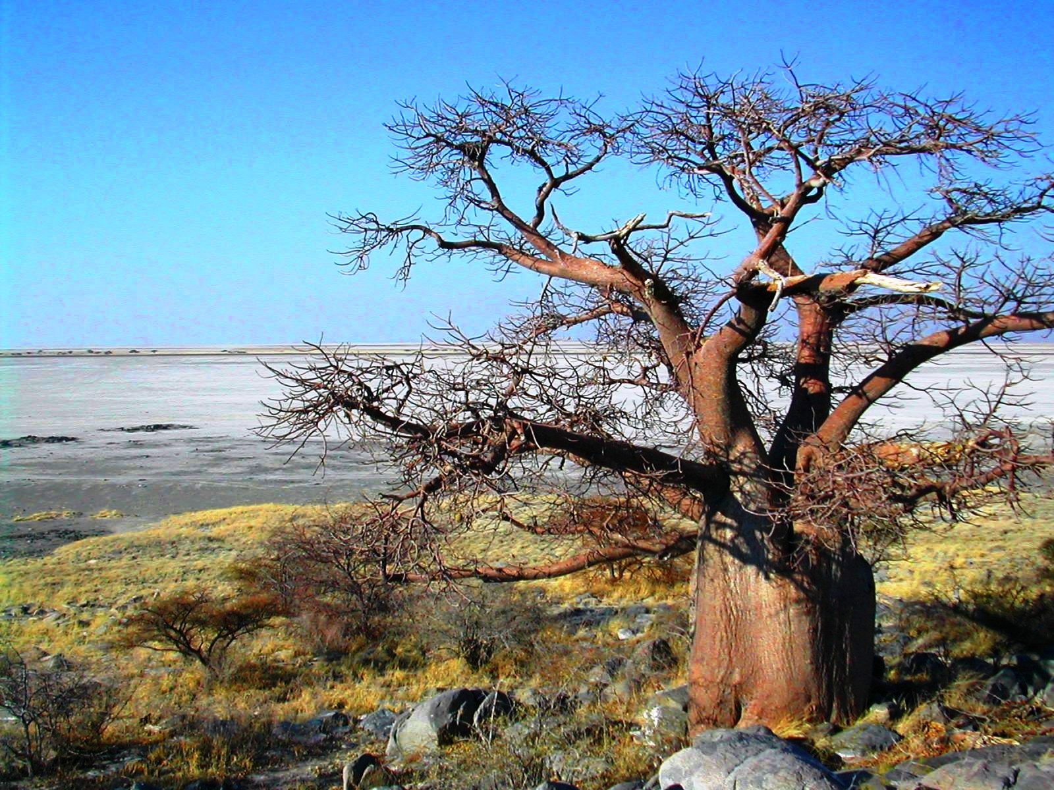

Slide 22
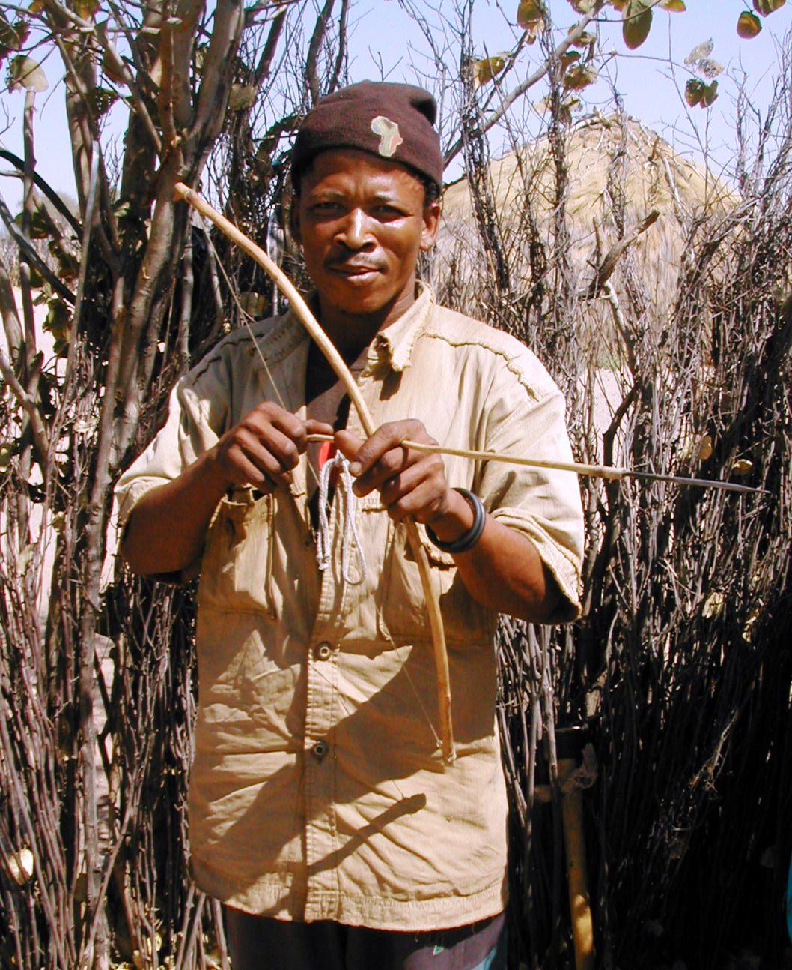
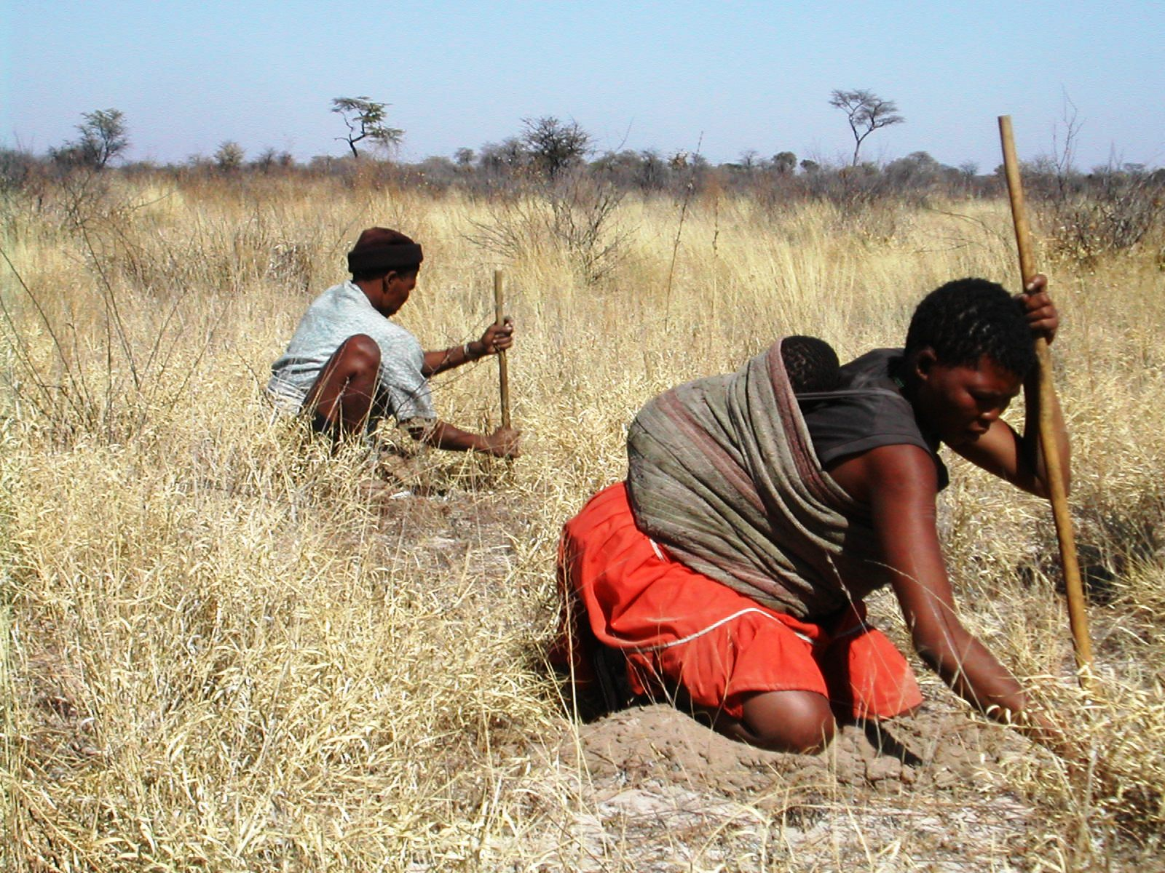
Earn

Slide 23
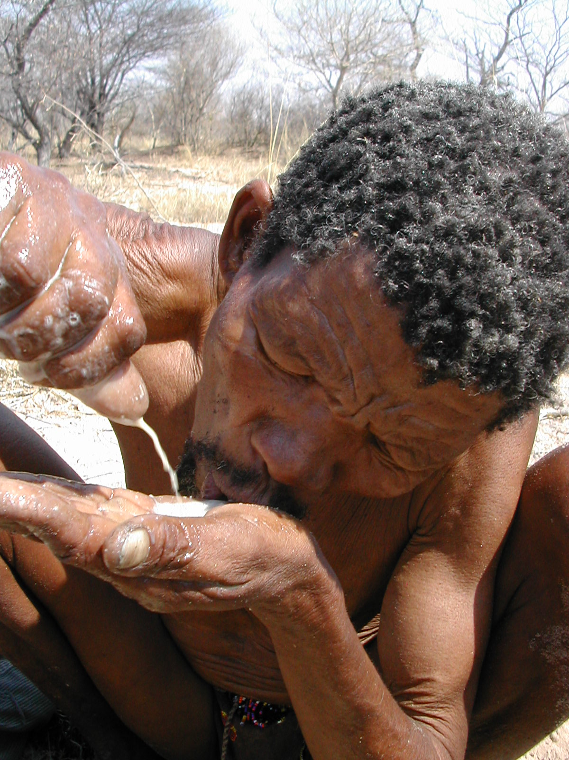
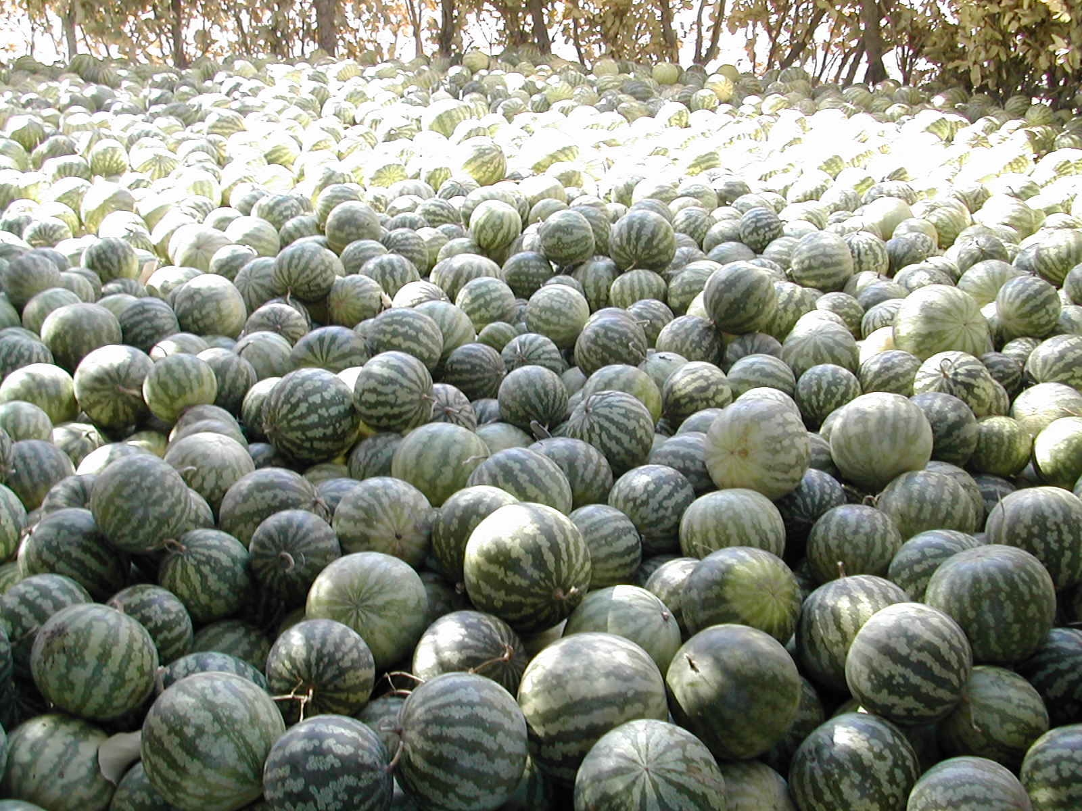
Own

Slide 24
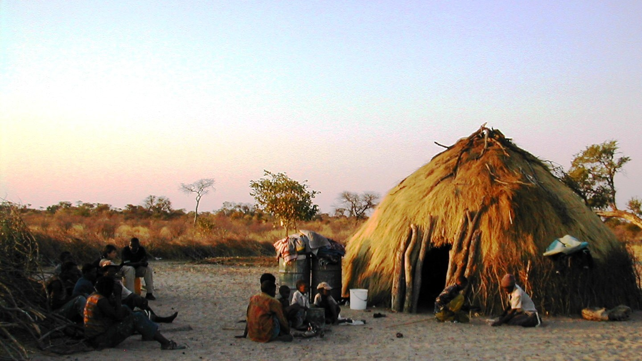
Trade

Slide 25
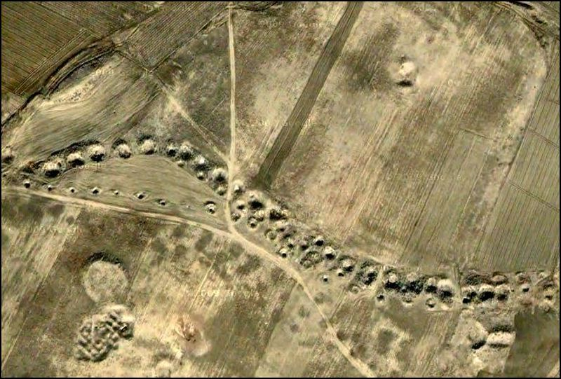
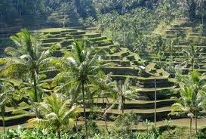
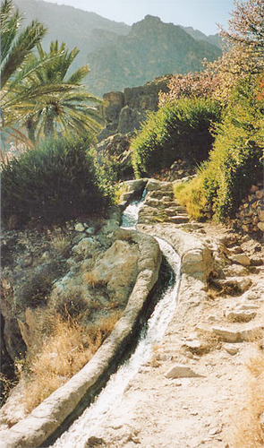
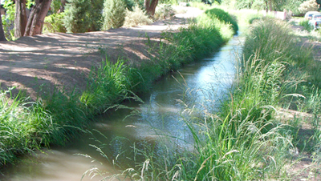
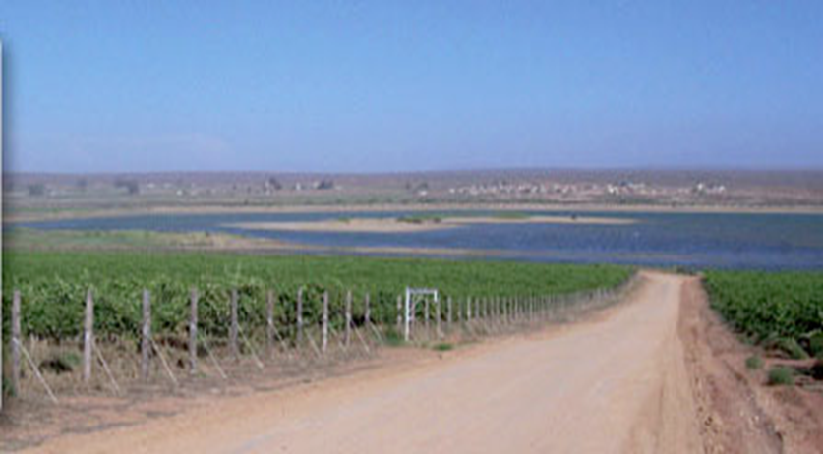
Success

Slide 26
+
=
?

Slide 27
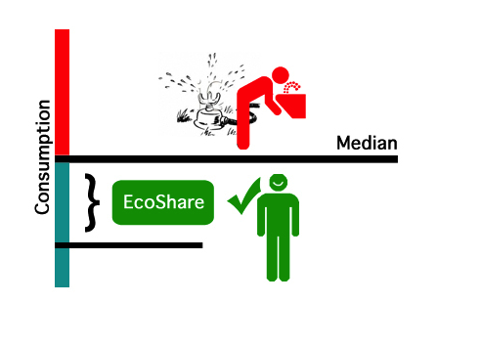
Earn
AquaMark™
1,000g

Slide 28
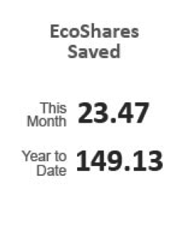
Own

Slide 29
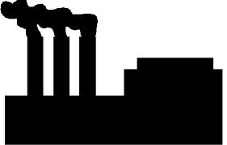
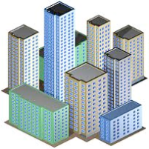
Trade
SELLERS
BUYERS
Neighbor
Business
Cause
Utility
City

Slide 30
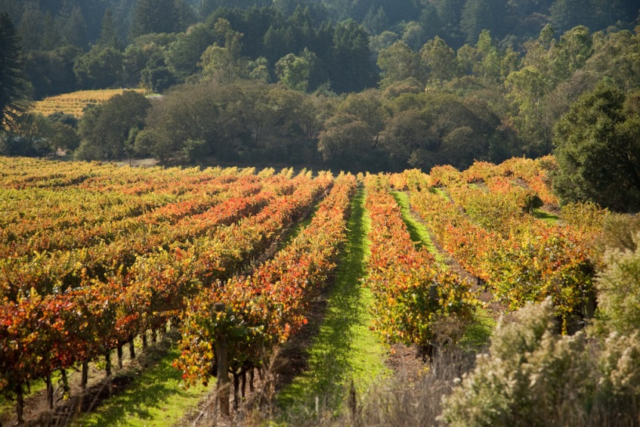
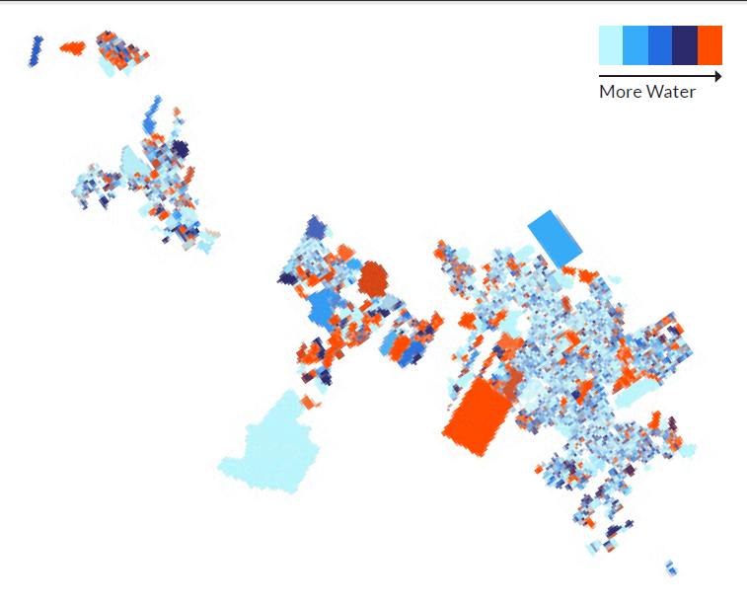
Pilot

Slide 32
