Slide 1
Community Microgrids & Solar Microgrids
Economic, environmental & resilience benefits
Craig Lewis
Executive Director
Clean Coalition
650-796-2353 mobile
craig@clean-coalition.org
13 May 2021

Slide 2
Clean Coalition (nonprofit)
Mission
To accelerate the transition to renewable energy and a modern grid through
technical, policy, and project development expertise.
100% renewable energy end-game
  25% local, interconnected within the distribution grid and facilitating resilience without dependence on the transmission grid.
  75% remote, dependent on the transmission grid for serving loads.
Notes:
2

Slide 3
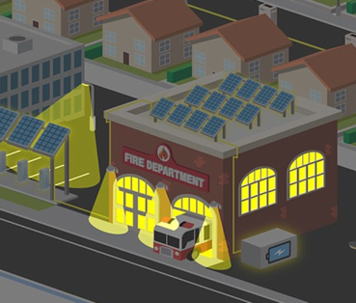
Value-of-resilience (VOR) depends on tier of load
Everyone understands there is significant value to resilience provided by indefinite renewables-driven backup power, especially for the most critical loads
  But, nobody has quantified this value of unparalleled resilience.
  Hence, there is a substantial economic gap for renewables-driven microgrids.
The Clean Coalition aims to establish a standardized value-of-resilience (VOR) for critical, priority, and discretionary loads that will help everyone understand that premiums are appropriate for indefinite renewables-driven backup power to critical loads and almost constant backup power to priority loads, which yields a configuration that delivers backup power to all loads a lot of the time
The Clean Coalition’s VOR approach aims to standardize resilience values for three tiers of loads:
  Tier 1 are mission-critical & life-sustaining loads and warrant 100% resilience. Tier 1 loads usually represent about 10% of the total load.
  Tier 2 are priority loads that should be maintained as long as long as doing so does not threaten the ability to maintain Tier 1 loads. Tier 2 loads usually represent about 15% of the total load.
  Tier 3 are discretionary loads make up the remaining loads, usually about 75% of the total load. Maintained when doing so does not threaten Tier 1 & 2 resilience.

Slide 4
Percentage of time online for Tier 1, 2, and 3 loads for a Solar Microgrid designed for the University of California Santa Barbara (UCSB) with enough solar to achieve net zero and 200 kWh of energy storage per 100 kW solar.
Typical load tier resilience from Solar Microgrids
Percentage of total load
Tier 3 = Discretionary load, ~75% of total load
Tier 2 = Priority load, ~15% of total load
Tier 1 = Critical, life-sustaining load, ~10% of total load
Percentage of time

Slide 5
A typical diesel generator is configured to maintain 25% of the normal load for two days. If diesel fuel cannot be resupplied within two days, goodbye. This is hardly a solution for increasingly necessary long-term resilience. In California, Solar Microgrids provide a vastly superior trifecta of economic, environmental, and resilience benefits.
Diesel generators are designed for limited resilience
Percentage of total load
Tier 3 = Discretionary load, ~75% of total load
Tier 2 = Priority load, ~15% of total load
Tier 1 = Critical, life-sustaining load, ~10% of total load
Percentage of time

Slide 6
GLP Community Microgrid case study
Goleta Load Pocket (GLP)
Community Microgrid
case study

Slide 7
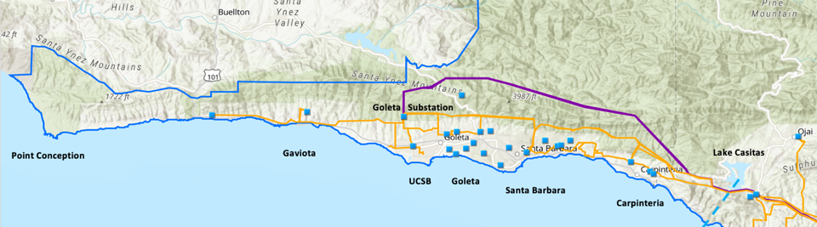
Goleta Load Pocket (GLP) and attaining resilience
The GLP is the perfect opportunity for a comprehensive Community Microgrid
GLP spans 70 miles of California coastline, from Point Conception to Lake Casitas, encompassing the cities of Goleta, Santa Barbara (including Montecito), and Carpinteria.
GLP is highly transmission-vulnerable and disaster-prone (fire, landslide, earthquake).
200 megawatts (MW) of solar and 400 megawatt-hours (MWh) of energy storage will provide 100% protection to GLP against a complete transmission outage (“N-2 event”).
  200 MW of solar is equivalent to about 5 times the amount of solar currently deployed in the GLP and represents about 25% of the energy mix.
  Multi-GWs of solar siting opportunity exists on commercial-scale built environments like parking lots, parking structures, and rooftops; and 200 MW represents about 7% of the technical siting potential.
  Other resources like energy efficiency, demand response, and offshore wind can significantly reduce solar+storage requirements.

Slide 8
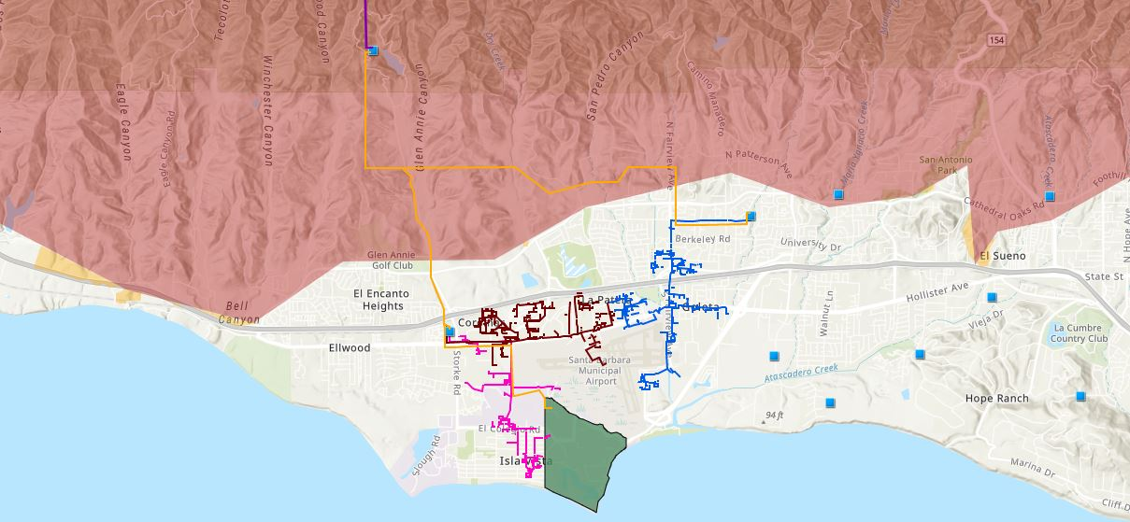


Target 66kV feeder at the core of the GLP
Goleta Substation
Goleta Water District West
Vegas Substation
Isla Vista Substation
UCSB
Legend
220 kV Transmission
16kV Gladiola Feeder
Tier 3 Fire Threat
Santa Barbara Airport
66 kV Feeder #4311
16kV Gaucho Feeder
Tier 2 Fire Threat
Sanitary or Water Districts
Substations
16kV Professor Feeder
University of California Santa Barbara (UCSB)

Slide 9
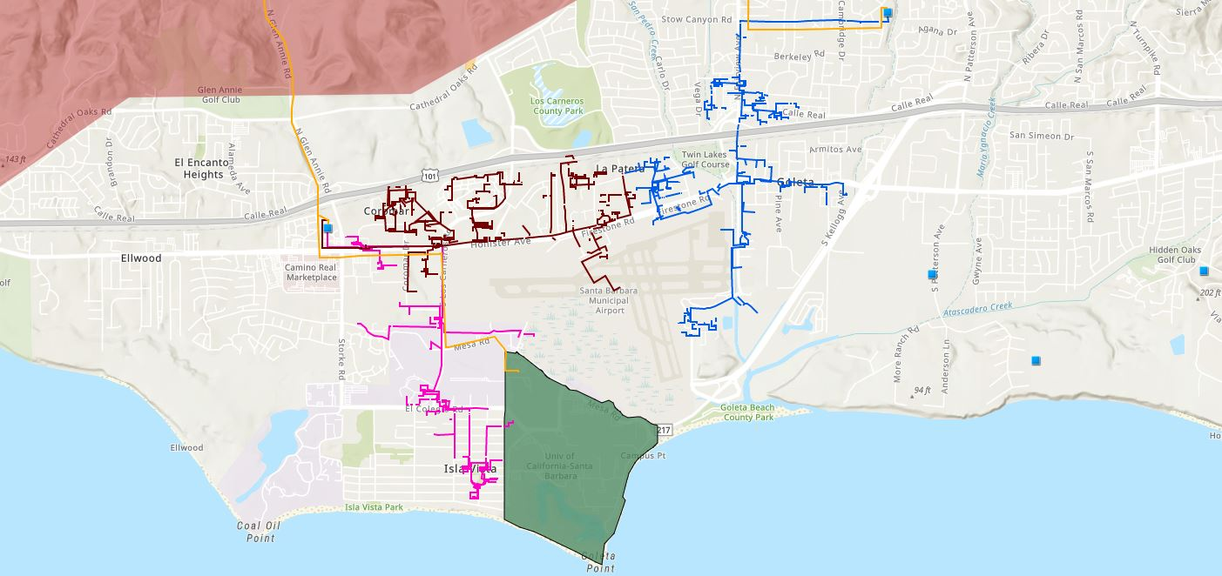





Target 66kV feeder serves critical GLP loads
Proposed 160-240 MWh Battery
Vegas Substation
Direct Relief
Isla Vista Substation
SB Airport
Fire Station # 8
Fire Station # 17
UCSB
Goleta Sanitary District
Legend
16kV Gladiola Feeder
Tier 3 Fire Threat
Goleta Valley Cottage Hospital
220 kV Transmission
16kV Gaucho Feeder
University of California Santa Barbara
Direct Relief
66 kV Feeder #4311
16kV Professor Feeder
Fire Stations
Deckers
Substations
Santa Barbara Airport
Sanitary or Water Districts
Proposed 160-240 MWh Battery

Slide 10

Target 66kV feeder grid area block diagram
Goleta Substation (220-to-66kV)
66kV distribution feeder #4311 with multiple branches
Vegas Substation (66-to-16kV)
Goleta Substation has eight feeders, all 66kV, that serve the entire GLP
Tier 2 & 3 facilities
66kV underground interconnection
Fire Station #8
Direct Relief
+ Solar Microgrid
Tier 2 & 3 facilities
Isla Vista Substation (66-to-16kV)
160+ MWh battery
Deckers
+ Solar Microgrid
SBA (runway lights & ATC)
Tier 2 & 3 facilities
Diagram Elements
66 kV Distribution Feeder #4311
16 kV Gladiola Feeder
16 kV Gaucho Feeder
16 kV Professor Feeder
Planned 160-240 MWh Battery
Grid isolation switch (open, closed)
Smart meter switch (open, closed)
Fire Station #17
SBA (Main Terminal)
Tier 2 & 3 facilities
Goleta Sanitary District
UCSB
+ Solar

Slide 11
SBUSD case study
Santa Barbara Unified School District (SBUSD)
case study

Slide 12
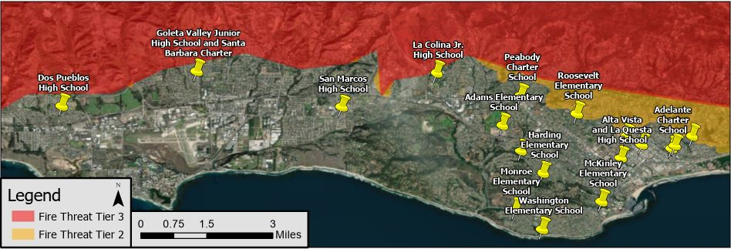
Santa Barbara Unified School District (SBUSD)
The entire Santa Barbara region is surrounded by extreme fire risk (earthquake & landslide risk too) and is extremely vulnerable to electricity grid outages.
The SBUSD is a major school district that increasingly recognizes the value-of-resilience (VOR) and has embraced the Clean Coalition’s vision to implement Solar Microgrids at a number of its key schools and other critical facilities.
SMHS is in the middle of the extensive SBUSD service area.

Slide 13
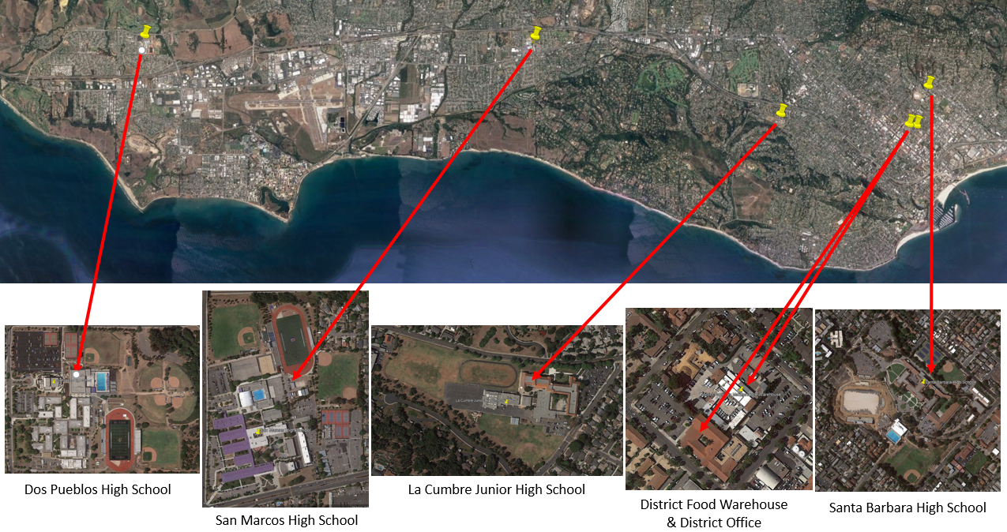
Six SBUSD Solar Microgrid sites

Slide 14
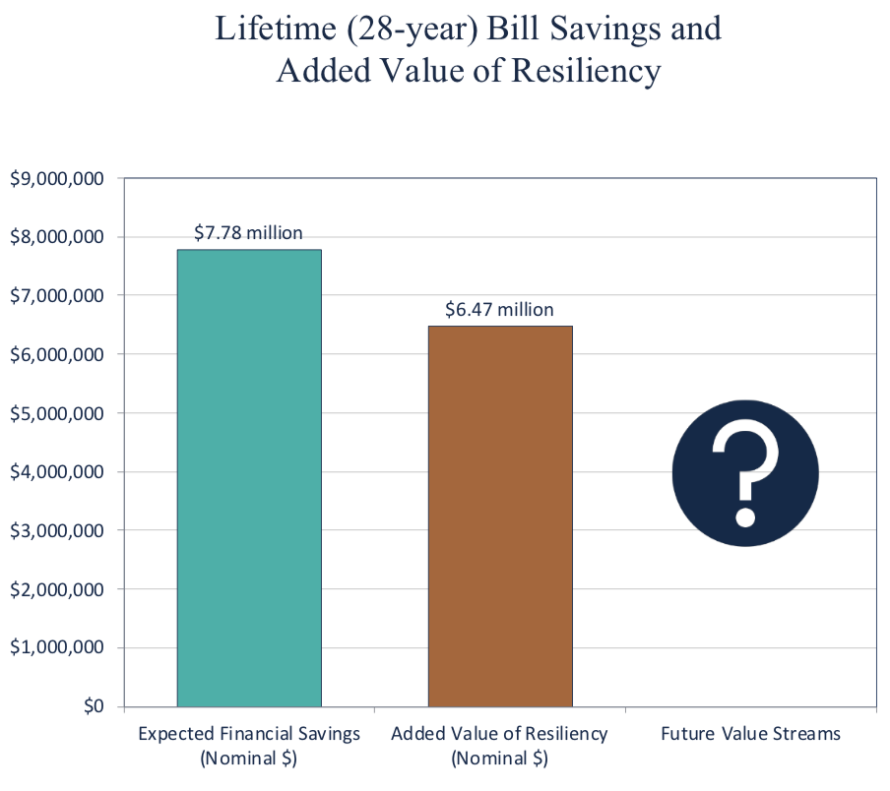
Guaranteed SBUSD bill savings and free VOR

Slide 15
VGES case study
Valencia Gardens Energy Storage (VGES)
case study

Slide 16
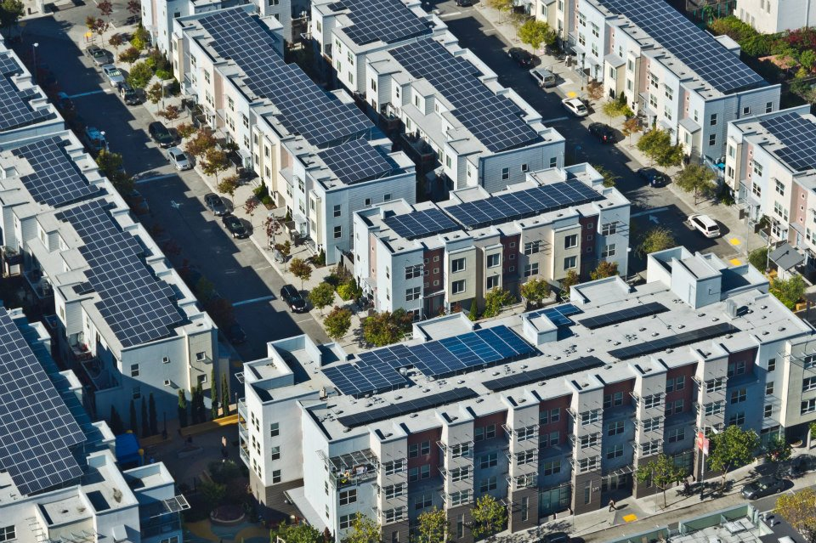
Valencia Gardens Apartments in San Francisco

Slide 17
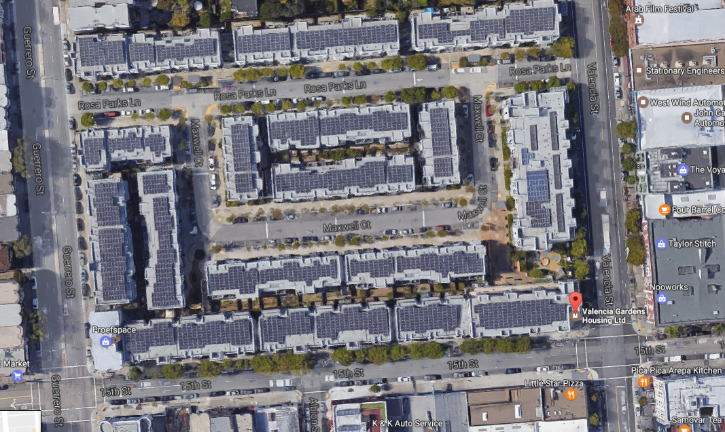
Lots of solar on the Valencia Gardens Apartments

Slide 18
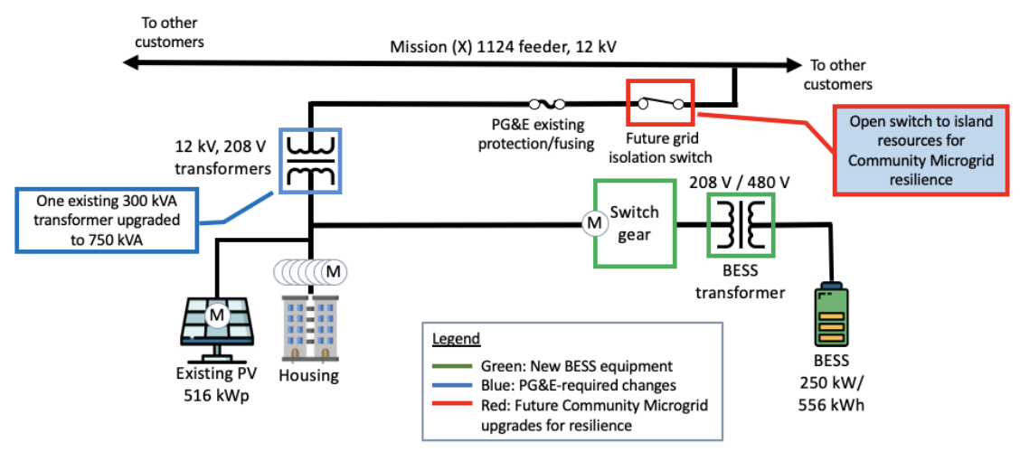
Future VGES Community Microgrid opportunity

Slide 19
Planning for resilience begins with tiering
Planning for resilience begins with tiering

Slide 20
Target 66kV feeder grid area block diagram
Goleta Substation (220-to-66kV)
66kV distribution feeder #4311 with multiple branches
Vegas Substation (66-to-16kV)
Goleta Substation has eight feeders, all 66kV, that serve the entire GLP
Tier 2 & 3 facilities
66kV underground interconnection
Fire Station #8
Direct Relief
+ Solar Microgrid
Tier 2 & 3 facilities
Isla Vista Substation (66-to-16kV)
160+ MWh battery
Deckers
+ Solar Microgrid
SBA (runway lights & ATC)
Tier 2 & 3 facilities
Diagram Elements
66 kV Distribution Feeder #4311
16 kV Gladiola Feeder
16 kV Gaucho Feeder
16 kV Professor Feeder
Planned 160-240 MWh Battery
Grid isolation switch (open, closed)
Smart meter switch (open, closed)
Fire Station #17
SBA (Main Terminal)
Tier 2 & 3 facilities
Goleta Sanitary District
UCSB
+ Solar

Slide 21
Percentage of time online for Tier 1, 2, and 3 loads for a Solar Microgrid designed for the University of California Santa Barbara (UCSB) with enough solar to achieve net zero and 200 kWh of energy storage per 100 kW solar.
Typical load tier resilience from Solar Microgrids
Percentage of total load
Tier 3 = Discretionary load, ~75% of total load
Tier 2 = Priority load, ~15% of total load
Tier 1 = Critical, life-sustaining load, ~10% of total load
Percentage of time

Slide 22
Facility & Load tiers of a Community Microgrid
Facility tiers
 | Tier 1 facility | Tier 2 facility | Tier 3 facility
Tier 1 load
Tier 2 load
Tier 3 load
Load
tiers
= Critical for the entire community, such as Tier 1 loads at Tier 1 facilities like fire stations
= Priority for the entire community, such as Tier 2 loads at Tier 1 facilities and Tier 1 loads at Tier 2
facilities like multi-unit housing facilities that can provide safe and easy sheltering in place
= Priority for individual facilities but not the entire community
= Discretionary loads that are not impactful to the community, whether on or off

